Slide 1
Data Analysis on HDB Properties
Alvin Lim

Slide 2
Dataset
Dataset name | Total number of rows | Total number of columns | Charts used | URL
Dataset 1 | 12877 | 24 | Line Chart | https://data.gov.sg/datasets/d_17f5382f26140b1fdae0ba2ef6239d2f/view
Dataset 2 | 140008 | 6 | Boxplot, Stacked bar chart | https://data.gov.sg/datasets/d_c9f57187485a850908655db0e8cfe651/view
Dataset 3 | 193212 | 11 | Histogram, bar chart | https://data.gov.sg/datasets/d_8b84c4ee58e3cfc0ece0d773c8ca6abc/view
Import datasets
Standardize/Transform data
Check for missing values
Analyse datasets

Slide 3
 | Dataset 1 | Dataset 2 | Dataset 3
Year | Residential and commercial buildings built since 1937 to 2024) | Rental approval from 2021 to 2024 | Resale flat transactions from 2017 to 2024
Unit breakdown | Breakdown of units by type (e.g., 1-room, 2-room, 3-room etc.) and if the total number of dwelling units in the building | Flat types: Information about different flat configurations (e.g., 3-room, 4-room). | Flat types: Information about different flat configurations (e.g., 3-room, 4-room).
Information about the nearby facilities around the buildings | The availability of markets, carparks, and miscellaneous. | X | X
Information about rental prices | X | ✔ | X
Information about sale prices | X | X | ✔
Location and BLK number | ✔ | ✔ | ✔
Date of completion | ✔ | X | ✔
Other distinct features of dataset | Categories buildings based on residential and commercial. | Did not contain flat type multigen. | Remaining lease date, floor area (square meters)

Slide 4
Questions
Are there specific periods with higher numbers of residential buildings completed since 1937?
What are the average monthly rents in Singapore by region?
How are different HDB flat types distributed across regions?
Do HDB resale prices depend more on their region or flat type (e.g., 3-room, 4-room)?
Notes:
My presentation aims to answer the following questions:
Are houses in Singapore getting smaller?
What are the monthly rents Singapore based on region?
The distribution of different HDB flat type based on region?
Are resale prices of prices of HDB affected by their region or flat type (e.g. 3 room, 4 room)? Specifically, I am interested to find out if the location of the HDB affects the price more than the flat type
Specifically, I am interested in determining whether the location of the HDB flat has a greater impact on resale prices compared to the flat type.

Slide 5
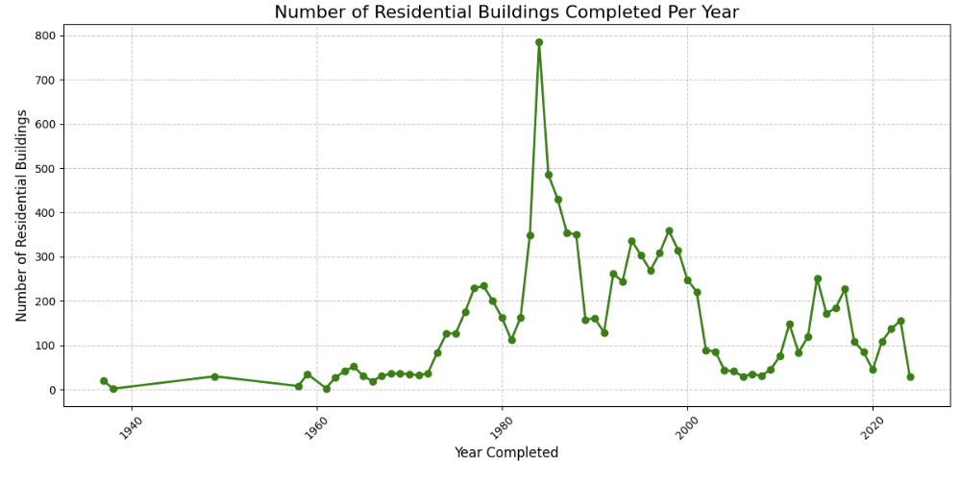
Dataset 1

Slide 6
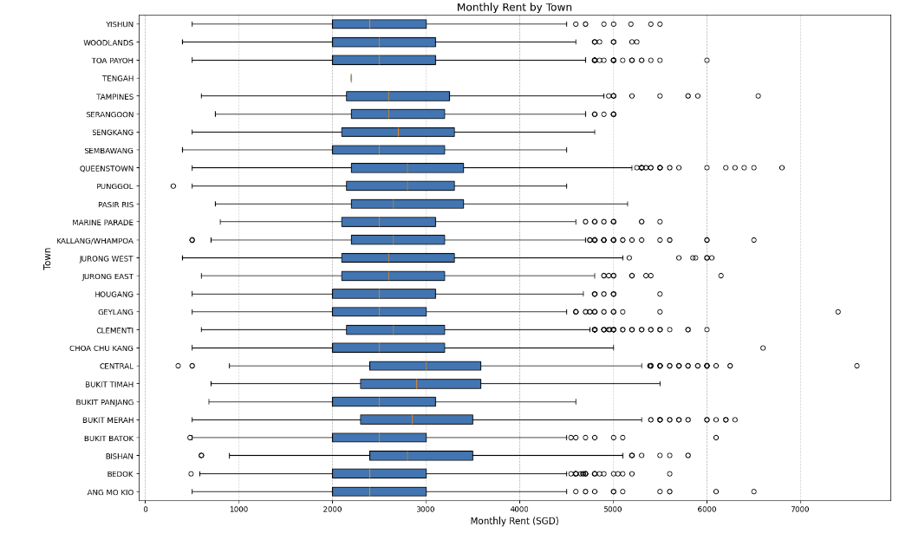
Dataset 2
Central areas (e.g., Queenstown, Bukit Timah, and Marine Parade) show higher rents
Outliers Across All Regions: Outliers exist even in traditionally lower-cost towns, likely due to larger flats (e.g., executive or premium renovations).
Notes:
Towns are listed along the vertical axis, and monthly rent in SGD is on the horizontal axis
Each box represents the interquartile range (IQR) (25th to 75th percentile)
Wide Variation Across Towns:
Central areas (e.g., Queenstown, Bukit Timah, and Marine Parade) show higher rents compared to towns like Woodlands, Yishun, and Choa Chu Kang.
Central areas also have more outliers, indicating premium properties.
Affordable Regions:
Towns like Woodlands, Yishun, and Sembawang show lower median rents, suggesting they are more affordable options.
Outliers Across All Regions:
Outliers exist even in traditionally lower-cost towns, likely due to larger flats (e.g., executive or premium renovations).
of rent prices for that town.

Slide 7
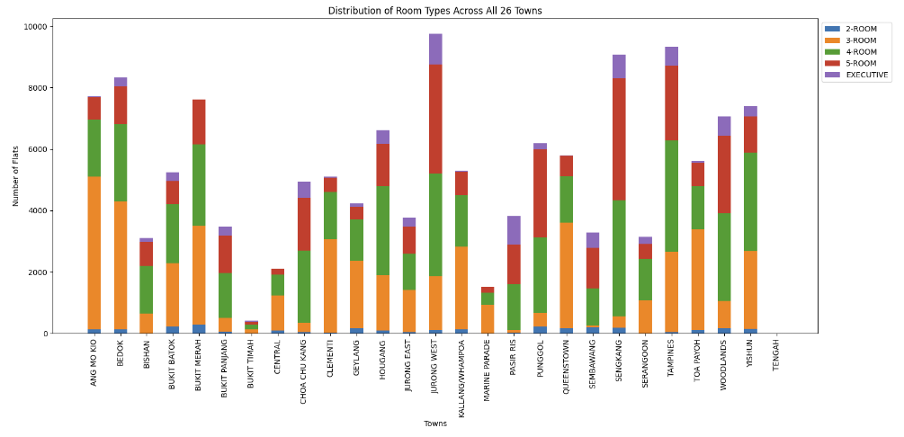
Dataset 2
Notes:
Observations:
Towns with the highest number of flats:
Jurong West and Tampines have the tallest bars, indicating the largest number of flats.
These towns have a wide variety of room types, with 4-room and 5-room flats being the most dominant.
Towns with the lowest number of flats:
Bukit Timah and Central have the shortest bars, indicating fewer flats overall. These towns have a smaller proportion of all room types.
Dominant room types:
Across most towns, 4-room flats (orange) are the most prevalent, followed by 5-room flats (red).
Executive flats (purple) are less common and appear in smaller proportions.
Variability among towns:
Some towns like Marine Parade and Bukit Timah have a noticeable lack of diversity in room types, with a heavy skew toward specific room types.
Towns like Jurong West and Tampines have a more even distribution across multiple room types.

Slide 8
Dataset 3 – data transformation
Dependent variable | Data type | Data transformation
Town | Categorical | 26 towns categorized into 5 dummy variables - regions (Northeast, East, Central, North, West)
Flat type | Categorical | 6 dummy variables ('1 ROOM', '2 ROOM', '3 ROOM', '4 ROOM', '5 ROOM', 'EXECUTIVE', 'MULTI-GENERATION)
Floor Area Sqm | Continuous | X
Remaining lease (years and months) | Continuous | Converted the remaining number of years and months into months
Outcome variable
Resale price | Continuous | X
Dropped Region (North) and Flat type (Room 1) in the regression model – this served as a baseline. Therefore, the results shown in the model are interpreted as the difference in the resale price compared to the baseline (North, 1-Room flat).

Slide 9
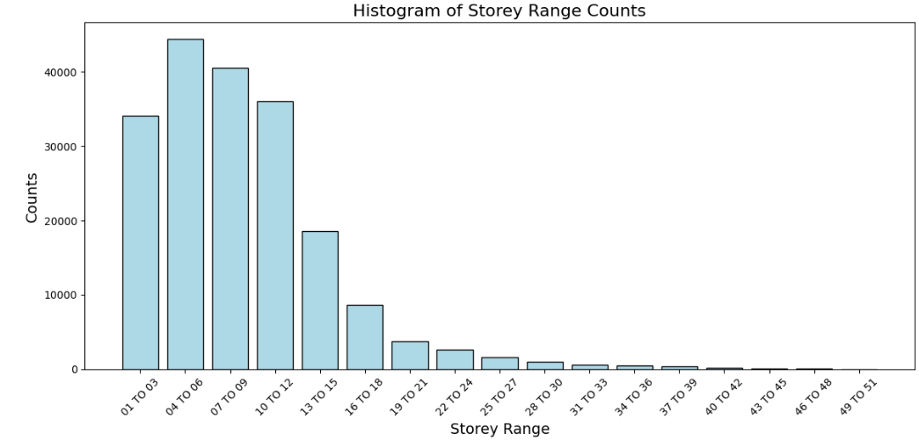
Dataset 3
Notes:
For the final dataset – wanted to see HDB resale prices affected more by their region or flat type (e.g., 3-room, 4-room)?
However, I did not include storey range as part of the regression model – given that the sample is uneven – as shown in the barchart.

Slide 10
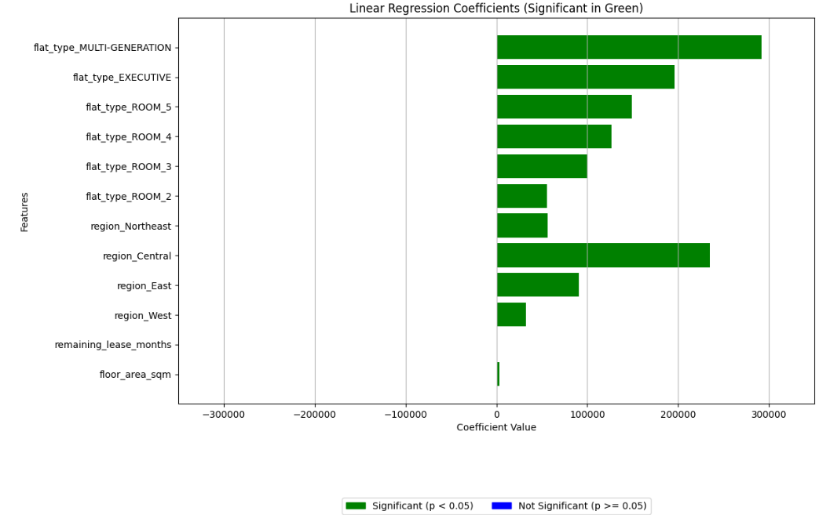
Dataset 3
Model Summary:
R-square: 0.601 (60.1%)
Coefficients: all significant (> 0.05)
Multi generation flat type may have a slightly larger influence on resale prices as compared to flats found in central region
For every additional square meter, resale price increases by approximately 3,525 SGD
For every additional month of lease, resale price increases by approximately 372 SGD, holding other variables constant
Notes:
To describe the graph and make a script, here's a detailed approach:
Description of the Graph:
Title: The graph shows the Linear Regression Coefficients for various features predicting the resale price of flats in Singapore. Coefficients marked in green are statistically significant (p < 0.05), while coefficients in blue are not significant (p ≥ 0.05).
Features: The x-axis represents the coefficient values, while the y-axis lists the independent variables in the model, including:
Flat Types (e.g., ROOM_2, ROOM_3, EXECUTIVE, MULTI-GENERATION)
Regions (e.g., Northeast, Central, West)
Continuous Variables (remaining lease months and floor area in square meters).
Interpretation:
Significant Variables: Features such as flat_type_MULTI-GENERATION and flat_type_EXECUTIVE have the highest positive impact on resale price, followed by flat_type_ROOM_5 and flat_type_ROOM_4.
Regional Effects: The region_Central has the most significant positive impact among regions, while other regions also show varying levels of influence.
Continuous Variables: Both remaining_lease_months and floor_area_sqm contribute positively to the resale price.
Excluded Variables: region_North and flat_type_ROOM_1 were excluded to avoid multicollinearity.
Significance: All the coefficients shown in the graph are significant (green bars), indicating a strong predictive model.
Script:
Introduction
"Good day, everyone. Today, I will present an analysis of the factors influencing resale prices of flats in Singapore, based on a multiple linear regression model."
Graph Explanation
"This graph highlights the regression coefficients of various features in the model, which predicts the resale price. The coefficients indicate how much the resale price is expected to change with a one-unit increase in the respective feature, holding all else constant."
Key Findings
Flat Types: "Among flat types, multi-generation flats contribute the most to resale price increases, with a coefficient nearing $300,000. Executive flats and larger room types such as 5-room flats also show significant positive contributions. This trend reflects the demand for larger and more luxurious housing options."
Regions: "Regionally, flats in the Central area exhibit the highest positive influence, adding over $230,000 to the resale price compared to the baseline region. This aligns with the Central area's reputation as a prime and well-connected location."
Continuous Variables: "Unsurprisingly, continuous variables such as floor area and remaining lease months are positively correlated with higher resale prices. Larger flats and those with a longer lease duration attract higher valuations."
Model Insights
"The model achieves an R-squared value of 0.601, indicating that 60.1% of the variation in resale prices is explained by the included variables. This demonstrates a strong model fit for predicting resale prices based on these factors."
Limitations
"However, it is important to note potential multicollinearity among some variables and external factors that may also influence resale prices but were not included in this model."
Conclusion
"In conclusion, this analysis sheds light on the significant impact of flat types, regions, and lease conditions on resale prices, providing valuable insights for stakeholders in the housing market."
"Thank you, and I welcome any questions."
Let me know if you need modifications or additional elements!

Slide 11
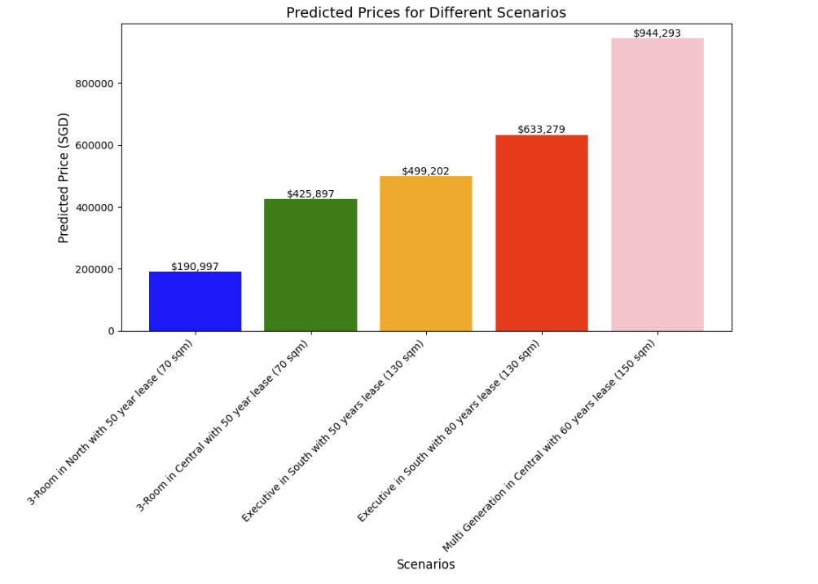
Dataset 3
Conclusion:
Mean Absolute Error (MAE): 88124.62.
The model's predictions are SGD 88,124.62 away from the actual resale prices.
Limitations of model:
Room for improvement (e.g., by adding more relevant features such as distance to MRT, nearby facilities/amenities etc.)
Did not conduct assumption testing to remove any outliers
Can consider the use of non-linear models
The resale prices found in the dataset are from 2021 to 2024.
Notes:
Insights
Scenario 1: 3-Room Flat in the North
"The predicted price for a 3-room flat located in the North region is approximately $190,997. This represents the lower end of the price spectrum, likely due to the flat's smaller size and less central location."
Scenario 2: 3-Room Flat in the Central Region
"In contrast, a 3-room flat in the Central region is predicted to fetch a significantly higher price of $425,897, reflecting the premium associated with prime central locations."
Scenario 3: Executive Flat with a 50-Year Lease
"Moving to larger flats, an Executive flat with a 50-year remaining lease is predicted to have a resale value of $499,202. This suggests that even with a shorter lease, the flat type contributes positively to the price."
Scenario 4: Executive Flat with an 80-Year Lease
"An Executive flat with an 80-year lease is predicted to command the highest price among the scenarios, at $633,279. This highlights the importance of lease length in determining flat value."
Model Performance
"The model's performance metrics are as follows:"
"The Mean Absolute Error (MAE) is $88,124.62, indicating that, on average, predictions deviate by around $88,000 from actual prices."
"The Mean Squared Error (MSE) is 12,448,814,637.39, representing the average squared difference between predicted and actual prices."
"The R-squared (R²) value is 0.60, showing that the model explains 60% of the variance in resale prices."
Conclusion
"In summary, the model provides valuable predictions for different housing scenarios, emphasizing the importance of location, flat type, and lease length. While the predictions are insightful, the error margins suggest room for improvement in the model's precision. Thank you, and I welcome any questions."

Slide 12
Thank you for your attention

